Slide 1
Jazz Journey
The origination and evolution of an ever-new music

Slide 2
It started in old New Orleans the land of white rice and red beans when those cats played their horns a new music was born jazz had now entered the scene.
www.jazzinamerica.org

Slide 3
New Orleans, LA
Early 1900s

Slide 4
Emancipation Proclamation, 1863
President Abraham Lincoln issued the Emancipation Proclamation on January 1, 1863, as the nation approached its third year of bloody civil war. The proclamation declared "that all persons held as slaves" within the rebellious states "are, and henceforward shall be free."
Julie Ann Johnson (Hudie Leadbelly Leadbetter)

Slide 5
Worship
Great Camp Meeting (Joe Williams & Chorus)
Africans, when brought to the US, were made to adopt Christianity. Along with the people came their musical traditions.
Spirituals were composed during days of slavery.
Songs filled with hopes of escape and freedom.
Call and Response.

Slide 6
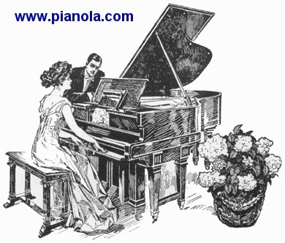
Scott Joplin
Rags or Ragtime for solo piano.
These were published as sheet music.
Recorded on piano rolls played by mechanical player pianos.
Maple Leaf Rag (Scott Joplin)

Slide 7
Congo Square
New Orleans park
Now called “New Orleans Jazz National History Park”
Place where African Americans met on Sundays to socialize.
Dance contest with winners winning a cake (cake walk).
Instrumental band version of Ragtime
Snake Rag (King Oliver's Creole Jazz Band)

Slide 8
Funeral Parade
Just after burial:
Oh, Didn't He Ramble (Kid Ory's Creole Jazz Band)
Afterwards…celebrating the life:
Oh, Didn't He Ramble (Kid Ory's Creole Jazz Band
Celebration in the hall:
Cake Walking Babies From Home (Red Onion Jazz Babies)
New Orleans style jazz or Dixieland.
Sidney Bechet, soprano sax Louis Armstrong, cornet

Slide 9
Prior to Emancipation Proclamation
People lived in harmony in New Orleans.
Creole musicians were educated and trained as classical musicians.
Whites and people of color were equal.
Jim Crow Laws after the slaves were freed.
Required separation of the races in public.
Creoles began making music with self-taught freed slaves.
Blending of elements of European classical music with the
spontaneous self-expression of the black musicians.

Slide 10
Glossary
Cake Walk * Jazz
Call & Response * Jim Crow Laws
Collective Improvisation * New Orleans Style Jazz
Congo Square * Player Piano
Creole * Ragtime
Improvisation * Spirituals
Dixieland * Syncopation
Emancipation Proclamation * Work Song

